Slide 1
Responsive Web Test Automation Strategy

Slide 2
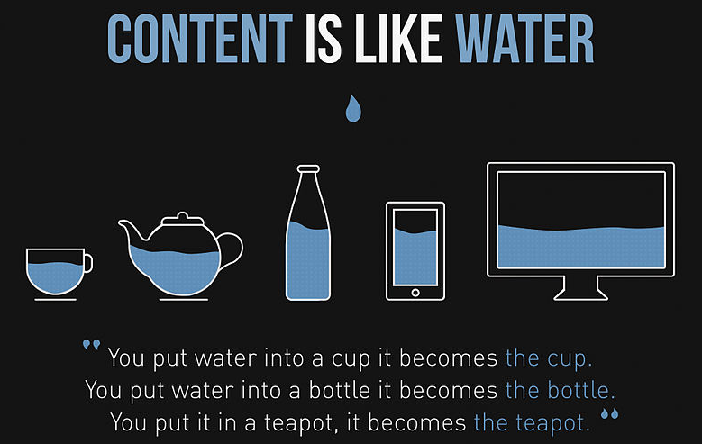
What is Responsive Web?
Web Page should be displayed on any platform (OS, Browser and Device)

Slide 3
What are the Platforms?
Operating Systems
Windows 7,8, 10
Mac –Lion, Yosemite
Android- Jelly Bins , Lollipop
IOS – 8.4, 9.2
Browsers
IE
Edge
Chrome
Firefox
Opera
Safari
Screen Resolutions
Desktop
Tab
Mobile
Devices
iPad
iPhone
Windows
Android
Operating System | 12
Browser | 45
Mobile Device Info | 1281
PhysiciansMutual.com – Analytics Report

Slide 4
Why RW Testing Different?
Traditional Use Case:
Customer should be able to get quote for dental product
Say, automated test would take 5 minutes to get the quote.
Responsive Use Case:
Customer should be able to get quote for dental product on latest 3 versions of
OS – Win, Linux, Mac, Android, iOS
Browser – IE, Chrome, Firefox, Safari
Screen Size – Desktop, Tab, iPhone, Android
Now, automated test would take 5x(5x3x4x3)x4 = 3600 minutes to get the quote on all platforms

Slide 5
Challenges
Sequential Execution
Limited Browser support – IE, Chrome, Firefox and Safari
Limited OS Support – Windows
Integration with Cloud Infrastructure not supported
Responsive Web Layout testing not supported
We are looking for a framework that COMPLEMENTS existing automation framework. NOT A REPLACEMENT

Slide 6
Proposed Solution
Selenium Web Driver automation framework
Parallel automation script execution
Supports 400+ platforms (Manual & Automation)
Internal Infrastructures
Secured Cloud based (SauceLabs) Infrastructures
Layout Testing
Integration with existing automation framework
Continuous Integration

Slide 7
Demo

